Slide 1
Relative Price and Relative Prosperity
By Chang-Tai Hsien and Peter J. Klenow

Slide 2
Introduction
Stylized fact 1:
One of the strongest relationship established in empirical growth literature : Positive correlation between investment rate in physical capital and GDP per capita of a country
Investment rate measured in international price
Rich countries High investment rate
Poor countries Low investment rate

Slide 3
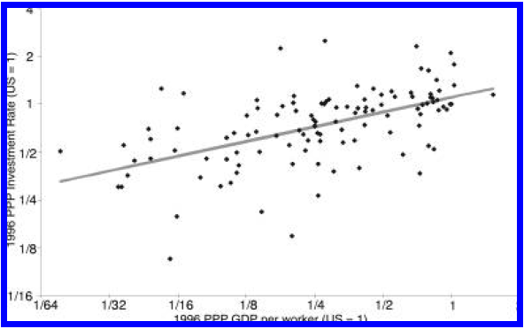
Introduction
Y axis: PPP investment rate X axis: PPP GDP per capita
Investment rate and GDP per capita are measured in PPP (purchasing power parity) price.

Slide 4
Introduction
Some explanations:
Low savings rate due to heavy tax on capital income or subsistence consumption needs in poor country
High cost of investment goods due to tax, barriers to investment goods imports or monopoly rights of domestic investment goods producers in poor countries.

Slide 5
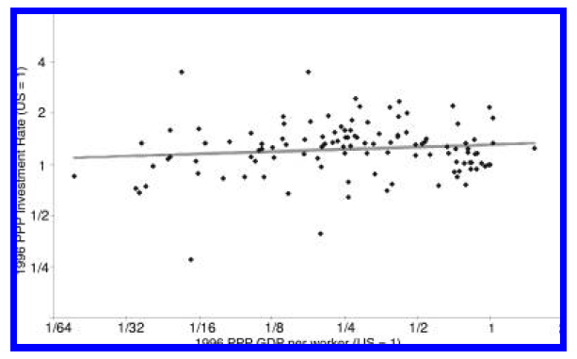
Introduction
Stylized fact 2: if measured in domestic price, the big difference between investment rate of rich country and that of poor country disappears.

Slide 6
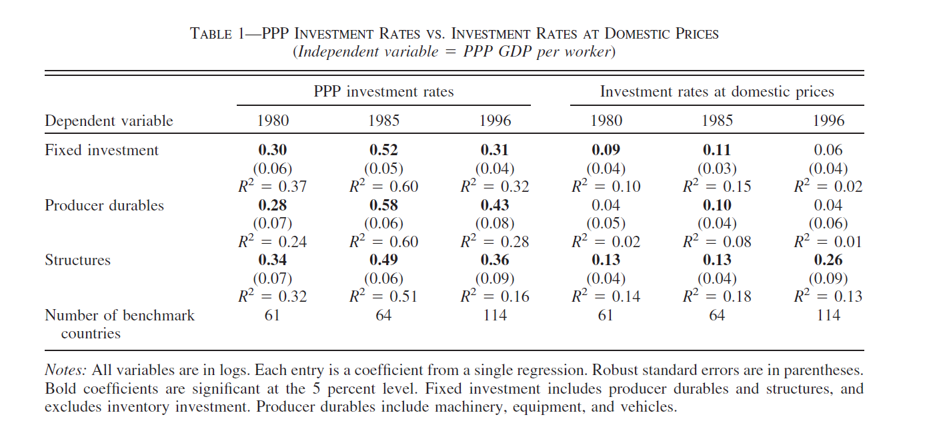
Introduction

Slide 7
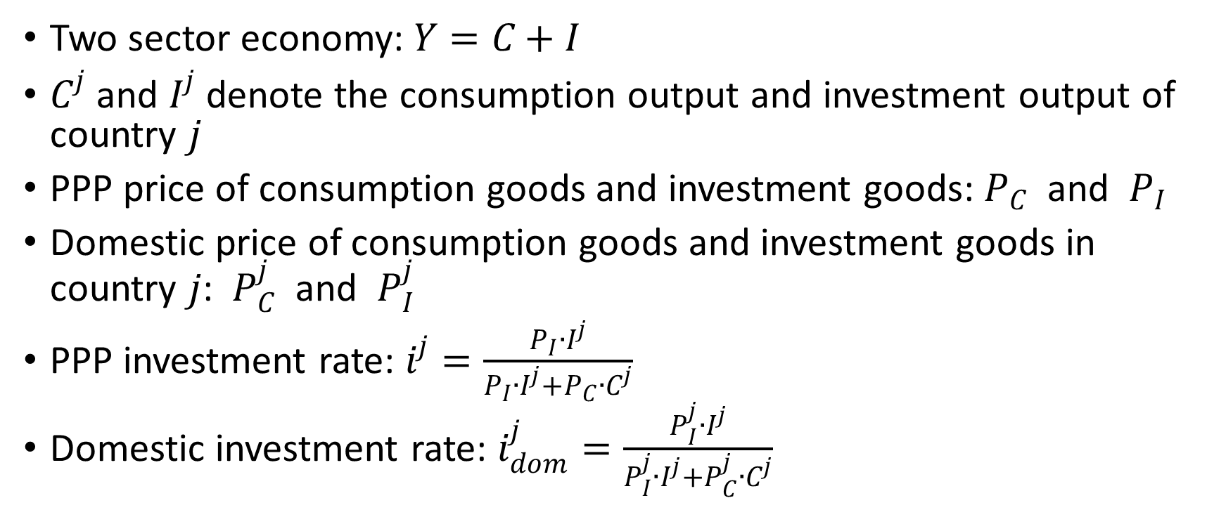
A Model Explanation
Two sector economy: $Y=C+I$
$C^{j}$ and $I^{j}$ denote the consumption output and investment output of country $j$
PPP price of consumption goods and investment goods: $P_{C}$ and $P_{I}$
Domestic price of consumption goods and investment goods in country $j$: $P_{C}^{j}$ and $P_{I}^{j}$
PPP investment rate: $i^{j}=\frac{P_{I}{∙I}^{j}}{P_{I}{∙I}^{j}+P_{C}{∙C}^{j}}$
Domestic investment rate: $i_{dom}^{j}=\frac{P_{I}^{j}{∙I}^{j}}{P_{I}^{j}{∙I}^{j}+P_{C}^{j}{∙C}^{j}}$

Slide 8
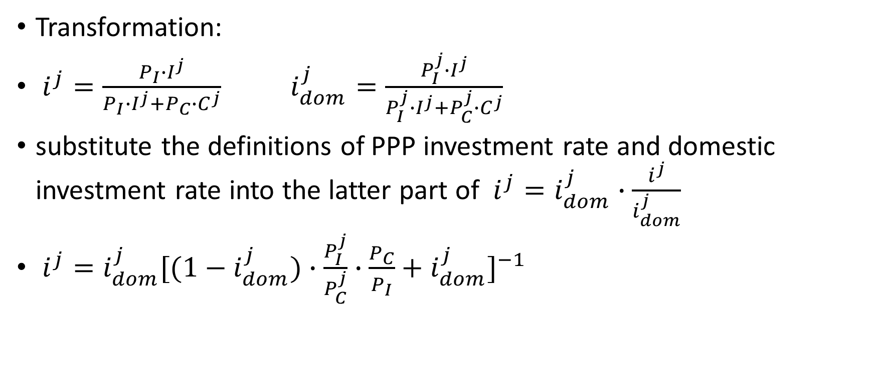
A Model Explanation
Transformation:
$i^{j}=\frac{P_{I}{∙I}^{j}}{P_{I}{∙I}^{j}+P_{C}{∙C}^{j}} i_{dom}^{j}=\frac{P_{I}^{j}{∙I}^{j}}{P_{I}^{j}{∙I}^{j}+P_{C}^{j}{∙C}^{j}}$
substitute the definitions of PPP investment rate and domestic investment rate into the latter part of $i^{j}=i_{dom}^{j}∙\frac{i^{j}}{i_{dom}^{j}}$
$i^{j}=i_{dom}^{j}{[(1−i_{dom}^{j})∙\frac{P_{I}^{j}}{P_{C}^{j}}∙\frac{P_{C}}{P_{I}}+i_{dom}^{j}]}^{−1}$

Slide 9

A Model Explanation
$i^{j}=i_{dom}^{j}{[(1−i_{dom}^{j})∙\frac{P_{I}^{j}}{P_{C}^{j}}∙\frac{P_{C}}{P_{I}}+i_{dom}^{j}]}^{−1}$
If country $j$ is a rich country,
$i^{j}=i_{dom}^{j}$ $\frac{P_{I}^{j}}{P_{C}^{j}}=\frac{P_{I}}{P_{C}}$
If country $j$ is a poor country,
$i^{j}<i_{dom}^{j} \frac{P_{I}^{j}}{P_{C}^{j}}>\frac{P_{I}}{P_{C}}$

Slide 10
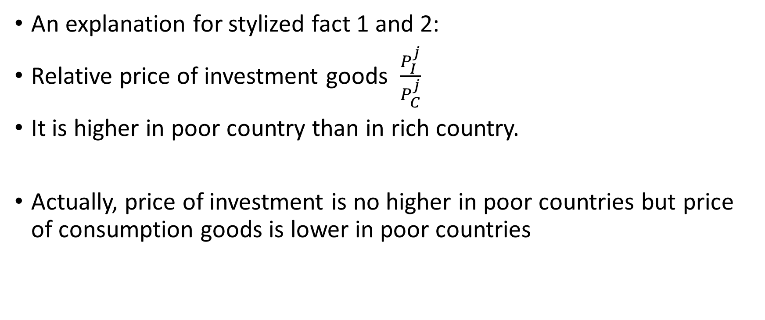
A Model Explanation
An explanation for stylized fact 1 and 2:
Relative price of investment goods $\frac{P_{I}^{j}}{P_{C}^{j}}$
It is higher in poor country than in rich country.
Actually, price of investment is no higher in poor countries but price of consumption goods is lower in poor countries

Slide 11
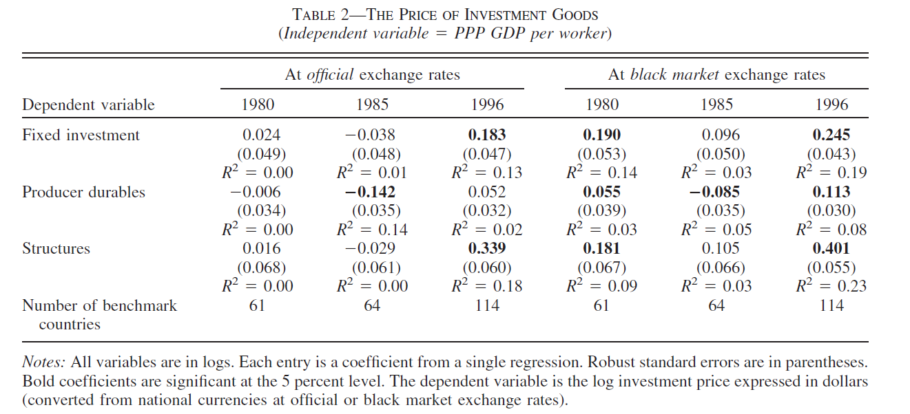
A Model Explanation

Slide 12
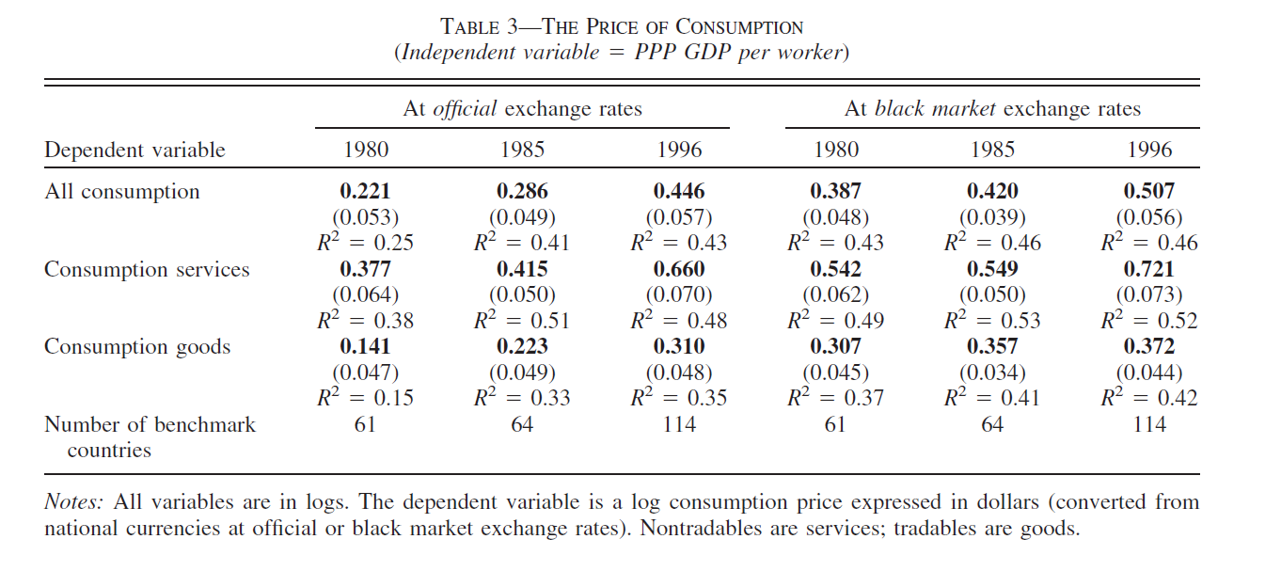
A Model Explanation

Slide 13
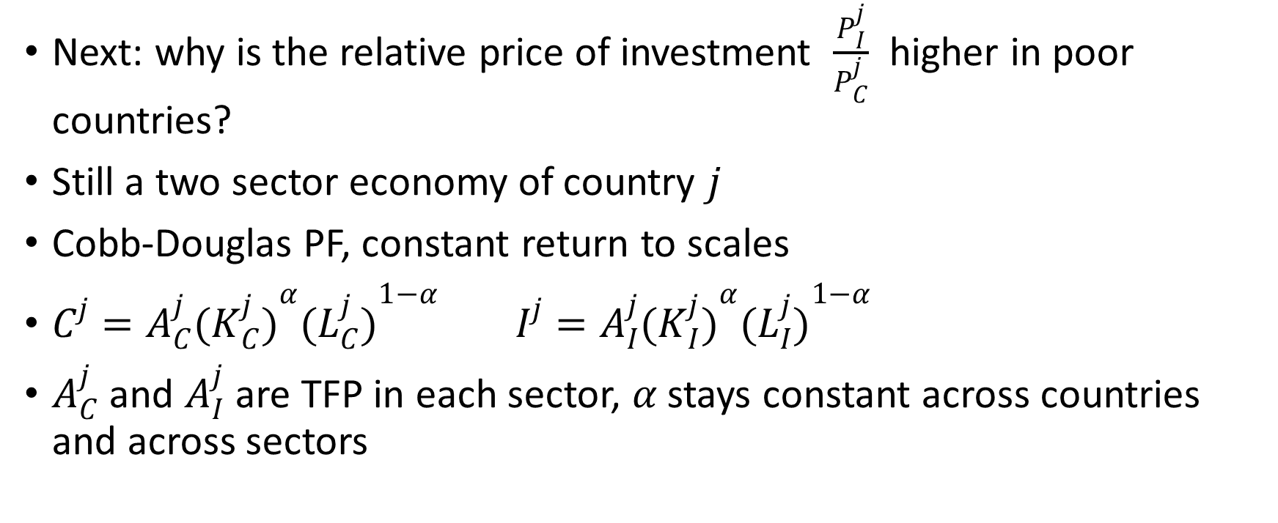
A Model Explanation
Next: why is the relative price of investment $\frac{P_{I}^{j}}{P_{C}^{j}}$ higher in poor countries?
Still a two sector economy of country $j$
Cobb-Douglas PF, constant return to scales
$C^{j}=A_{C}^{j}({K_{C}^{j})}^{α}({L_{C}^{j})}^{1−α} I^{j}=A_{I}^{j}({K_{I}^{j})}^{α}({L_{I}^{j})}^{1−α}$
$A_{C}^{j}$ and $A_{I}^{j}$ are TFP in each sector, $α$ stays constant across countries and across sectors

Slide 14
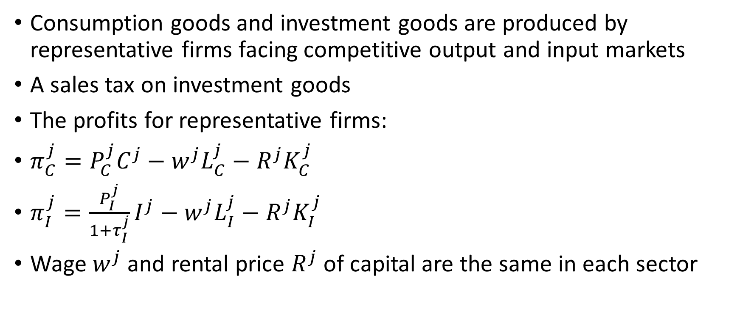
A Model Explanation
Consumption goods and investment goods are produced by representative firms facing competitive output and input markets
A sales tax on investment goods
The profits for representative firms:
$π_{C}^{j}=P_{C}^{j}C^{j}−w^{j}L_{C}^{j}−R^{j}K_{C}^{j}$
$π_{I}^{j}=\frac{P_{I}^{j}}{1+τ_{I}^{j}}I^{j}−w^{j}L_{I}^{j}−R^{j}K_{I}^{j}$
Wage $w^{j}$ and rental price $R^{j}$ of capital are the same in each sector

Slide 15
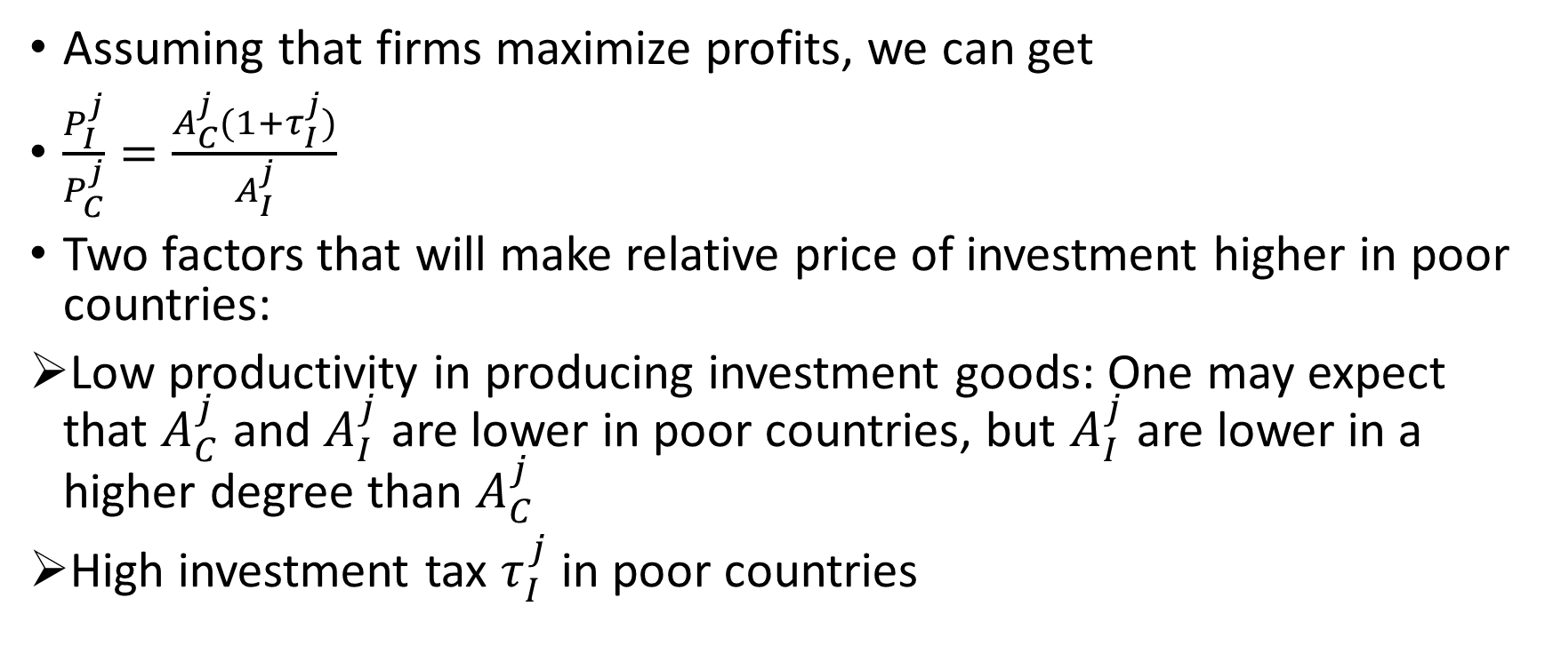
A Model Explanation
Assuming that firms maximize profits, we can get
$\frac{P_{I}^{j}}{P_{C}^{j}}=\frac{A_{C}^{j}(1+τ_{I}^{j})}{A_{I}^{j}}$
Two factors that will make relative price of investment higher in poor countries:
Low productivity in producing investment goods: One may expect that $A_{C}^{j}$ and $A_{I}^{j}$ are lower in poor countries, but $A_{I}^{j}$ are lower in a higher degree than $A_{C}^{j}$
High investment tax $τ_{I}^{j}$ in poor countries

Slide 16
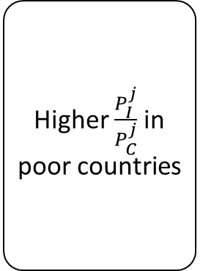



Conclusion
There are several explanations for stylized fact 1
But if take stylized fact 2 into account, low productivity in producing investment goods and high investment tax in poor countries may be the two most credible explanations
Low $A_{I}^{j}$
Higher $\frac{P_{I}^{j}}{P_{C}^{j}}$ in poor countries
For rich countries: $i^{j}=i_{dom}^{j}$
For poor countries: $i^{j}<i_{dom}^{j}$
Stylized fact 1 and 2
High $τ_{I}^{j}$

Slide 17
Thank You !

